Slide 1

Stage 4 There Is A Reason Course Designer: David Mandros & Ken Wang
There Is A Reason is a 22 round, 110 point, COMSTOCK Long course. There are 9 USPSA targets and 4 steel targets. The best 2 hits per cardboard target will score. Steel must fall to score.
The Handgun start position is standing with feet touching the marks, wrists below belt. Handgun loaded and holstered. The PCC start position is standing with feet touching the marks, PCC loaded, stock on belt, safety on.
On the audible start signal, engage all targets from within the shooting area.

Slide 2
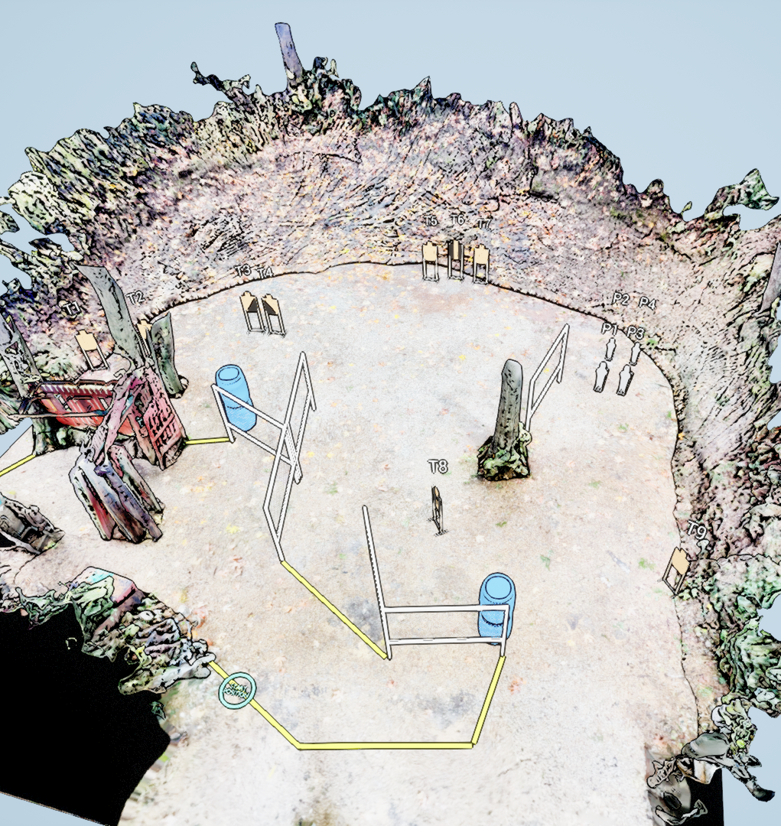
 | Stage 4 There Is A Reason Course Designer: David Mandros & Ken Wang

